Slide 1
Commercial Card
Expense Reporting (CCER)
Brandeis University
An internet solution
Accessed via Wells Fargo’s secure Commercial Electronic Office® (CEO) portal
© 2012 Wells Fargo Bank, N.A. All rights reserved. Confidential.

Slide 2
Commercial Card Expense Reporting (CCER)
What is it?
CCER is an internet reporting solution that allows on-line access to your card transactions at any time, from any location. It is accessed via Wells Fargo’s secure Commercial Electronic Office® (CEO) portal.
Cardholders can:
Review/reclassify transactions
Input a business description for all transactions
Split transactions
Email or fax in receipts
Approvers can:
Review/approve cardholder statements
View receipts and statement summary reports

Slide 3
Reconciliation cycle
Cardholder review period
  An email will be sent out to cardholders when the statements are ready for review. Emails will be sent even if the cardholder doesn’t have any transactions.
  If the cardholder has not reviewed the statement after 2 calendar days, a reminder email will be sent out. Cardholders will have an additional 2 days to complete the review.
  All statements must be reviewed during a 4 calendar day period each Cycle. If you are on vacation or do not have access to a computer, contact your program administrator.
Cardholder statement review period:
Statement cut-off is every other Monday,
review period is Tuesday-Friday

Slide 4
E-Mail notification
Cardholder statement ready for review
Statement review for 05/31/20XX
Dear Cardholder:
Your most recent statement is ready for review by accessing the Wells Fargo Commercial Card Expense Reporting system for the following card(s):
xxxx-xxxx-xxxx-1234
Please complete your review in a timely manner and forward your receipts as appropriate.
This is an automated email. Please do not reply to this message.

Slide 5
Reconciliation cycle
Approver period/deadline
  An email will be sent to the approver once the cardholder has finished reviewing the statement indicating to the approver that the statement is now ready to be reviewed/approved.
  Approvers must have all statements approved by 4 calendar day after the end of the cardholder period.
  If you are on vacation or do not have access to a computer, contact your program administrator so a secondary approver can be assigned to your cardholders.
Approver deadline:
Every other Saturday
(cardholder review period is Tuesday-Friday)

Slide 6
E-Mail notification
Approver mail (after grace period end date)
Cardholder statement review overdue for 05/31/20XX
Dear Approver:
The following cardholder(s) have not reviewed their most recent statement:
Lastname, Firstname xxxx-xxxx-xxxx-1234
Lastname, Firstname xxxx-xxxx-xxxx-5678
Notifications have been sent to each cardholder but they have still failed to review their statement. If you choose, you may review the statement on the cardholder’s behalf by accessing the Wells Fargo Commercial Card Expense Reporting system.
This is an automated email. Please do not reply to this message.

Slide 7
E-Mail notification
Cardholder review of statement is complete
Cardholder statement review complete
Dear Approver:
The most recent statement has been reviewed for the following cardholder:
Lastname, Firstname
xxxx-xxxx-xxxx-1234
xxxx-xxxx-xxxx-5678
The statement(s) are ready for your review by accessing the
Wells Fargo Commercial Card Expense Reporting system
Please complete your review in a timely manner.
This is an automated email. Please do not reply to this message.

Slide 8
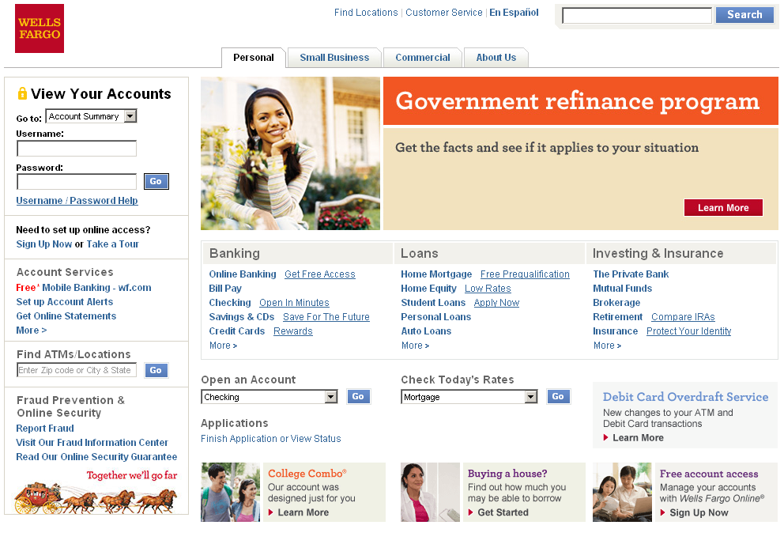
Logging in
Go to www.wellsfargo.com Click on the “Commercial” tab

Slide 9
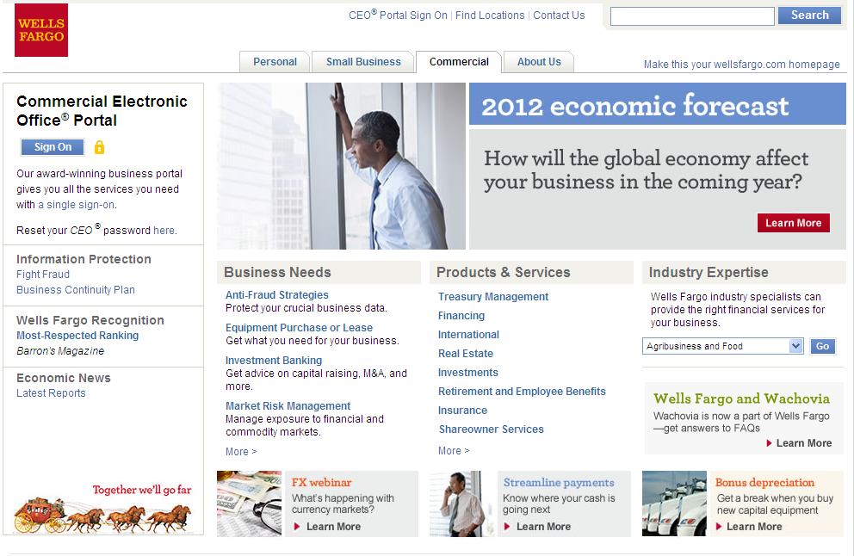
Logging in
Click on “Sign On”

Slide 10
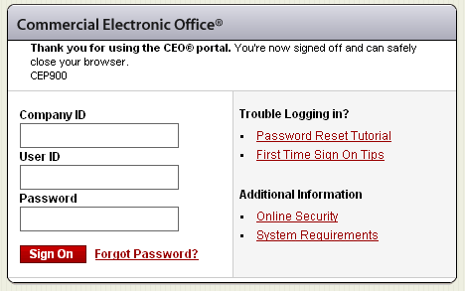
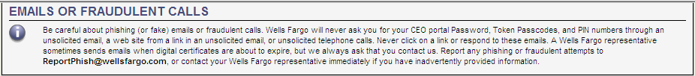
Commercial Electronic Office sign on
Simply enter your:
  Company ID
    Brand893
  User ID
    Unique to user
  Password
    Unique to User
Bookmark this page for future access

Slide 11
Your first sign-on
Change your temporary password
Answer two “secret questions”
Read and accept the CEO Terms of Use Agreement
Create a user profile:
  Name, title
  Telephone number
  Email address

Slide 12
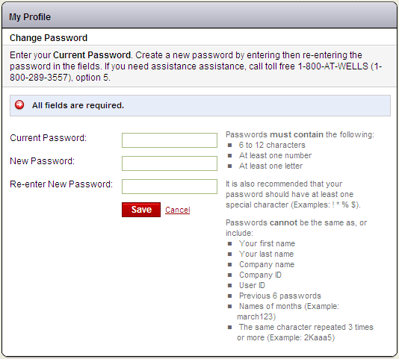
Change password

Slide 13
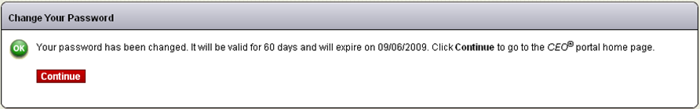
Change password
After selecting a new password, you will see a message box indicating the successful change of the password along with the date when the password will expire

Slide 14
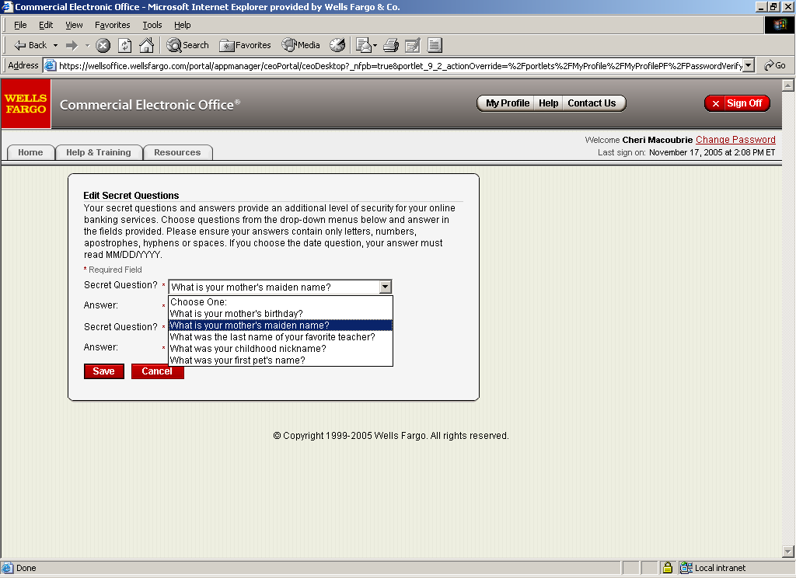
Answer two secret questions
Reset your own password in CCER
      Select a question from the drop down list
      Provide an answer
      Repeat the process with a different question
      Remember the answers!

Slide 15
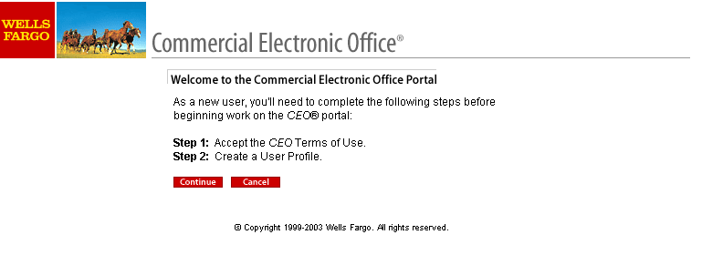
Next steps
This screen lets you know what you have left to accomplish:
Step 1: Accept the CEO Terms of Use
Step 2: Create a User Profile

Slide 16
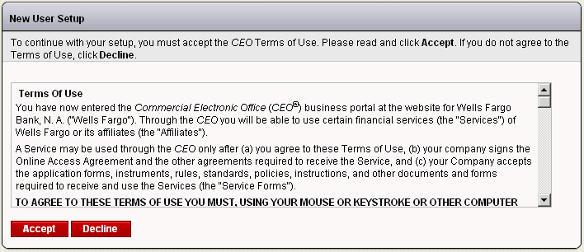
Read and accept the CEO Terms of Use

Slide 17
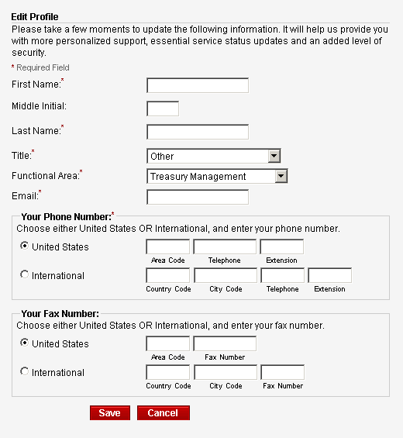
Edit the Profile so we can offer more personalized support

Slide 18
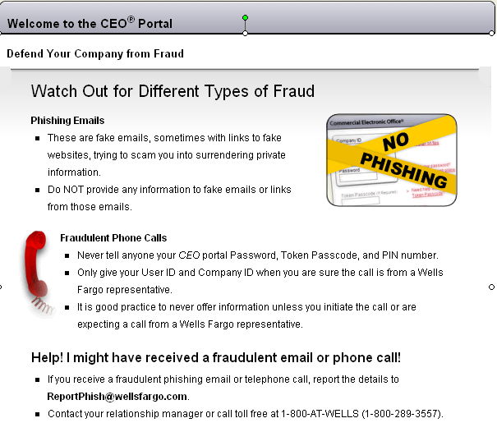

Slide 19
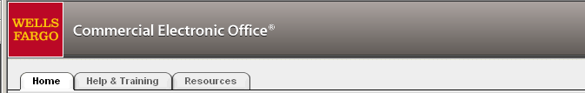

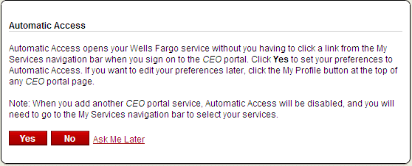
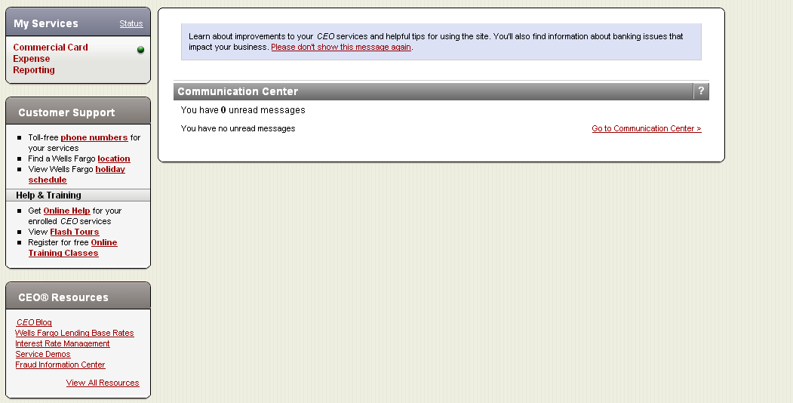
CEO Home Page
Select Commercial Card Expense Reporting from the “my services” menu, or sign up for Automatic Access
Click for a listing of online classes
Attend free training calls through Wells Fargo’s Treasury Management University
Calls will last no more than one hour and include ample time for your questions. You will learn how to:
  Sign on to the Commercial Electronic Office (CEO) portal and begin a CCER session
  Review current and previous statements and cycle-to-date transactions
  Manage your transactions (adding descriptions, reclassifying, splitting and more)
  View your personal profile, reports and other information
For the best training experience, we recommend using a high-speed connection during the call

Slide 20
Cardholder experience

Slide 21
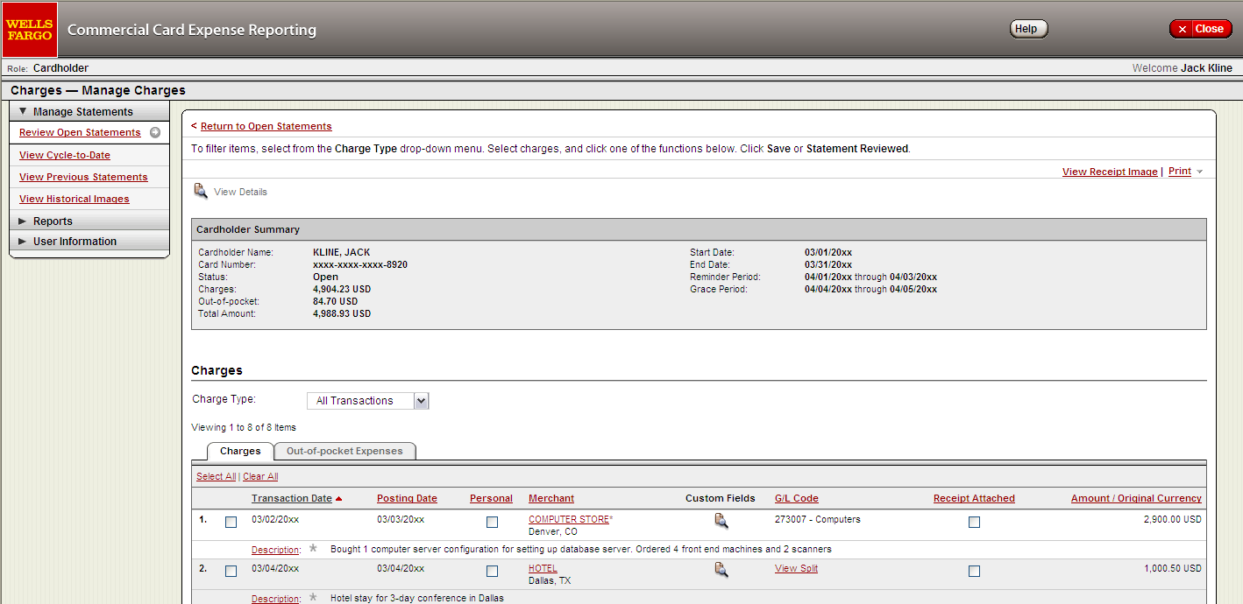
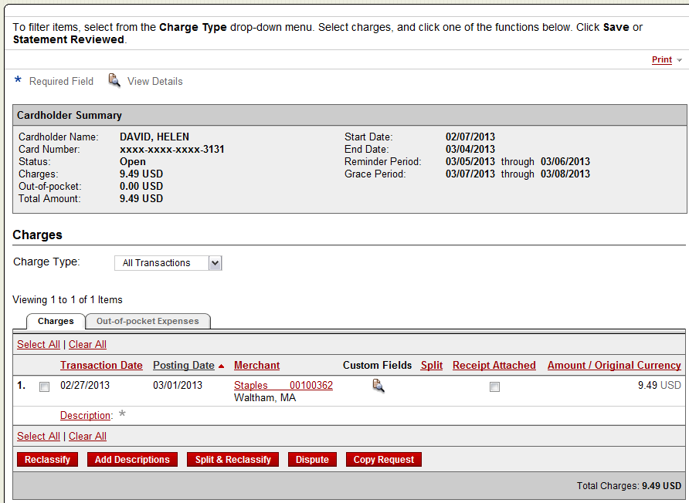
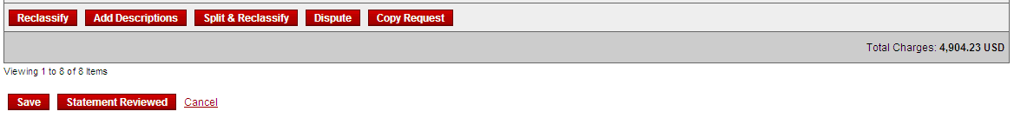
  Manage Statements
  Review open statements (default screen for cardholders)
  Finalize the statement during the review period

Slide 22
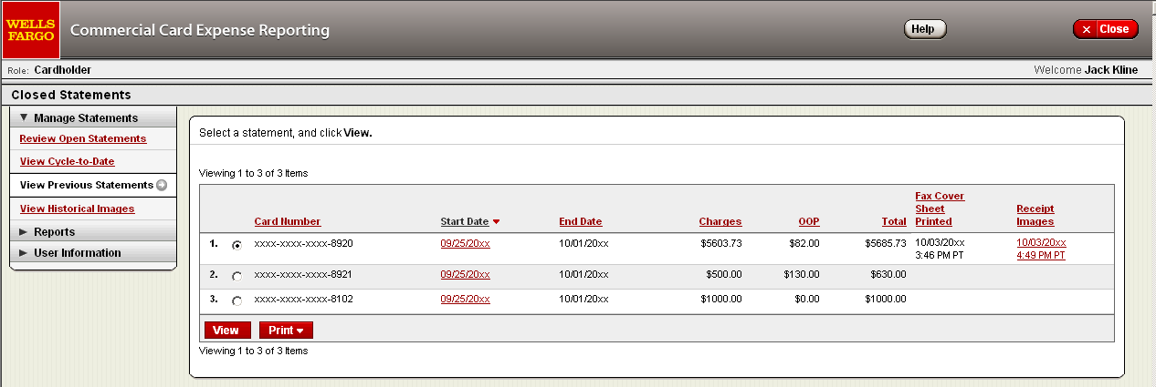
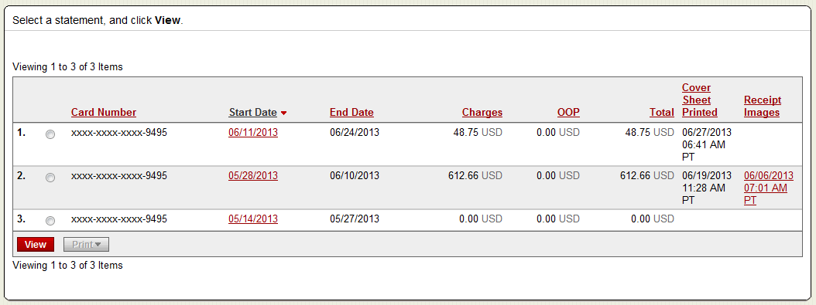
  Manage Statements
  View previous statements
  13 months of history

Slide 23
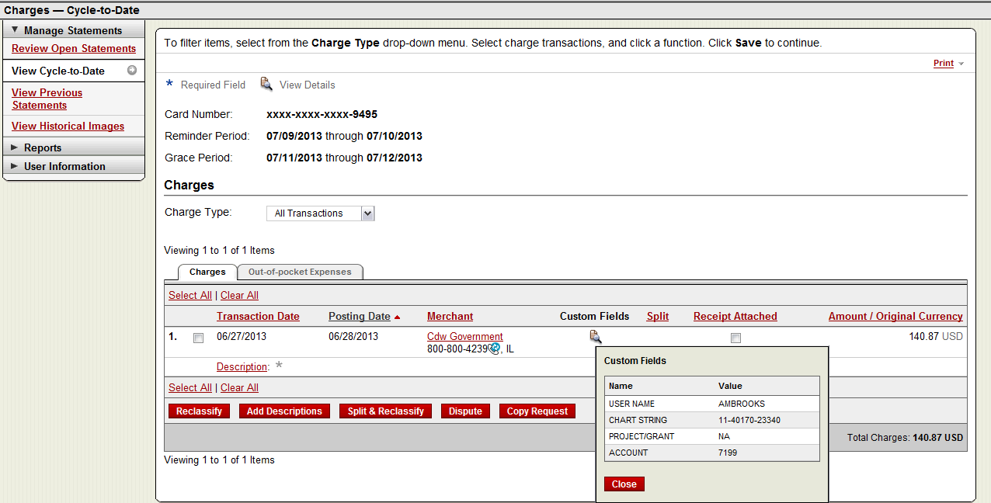

  Manage Statements
  View cycle-to-date transactions
  Appear on your statement as they are posted through the Visa® system

Slide 24
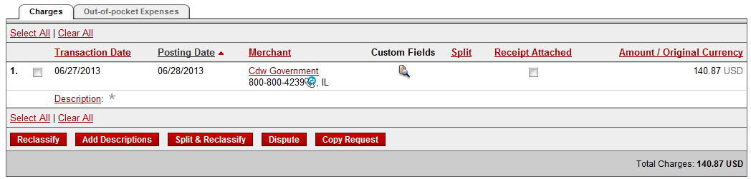
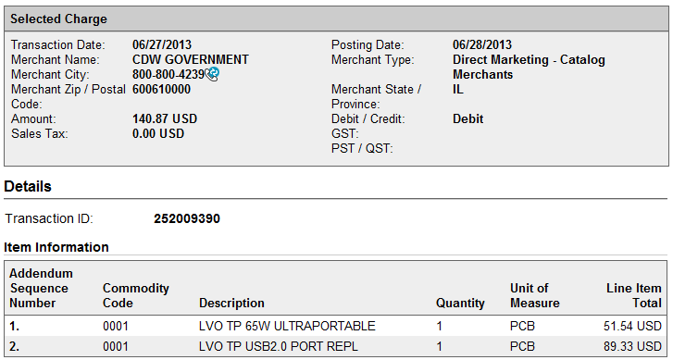
If a vendor transmits
additional details with
the transaction, the
merchant name is
red and underlined
Select the merchant name to access the detail screen

Slide 25

Available functionality includes:
  Reclassify - allocate an entire transaction and add a description
  Add Descriptions - provide transaction details
  Split and Reclassify - divide a transaction multiple ways and add descriptions
  Dispute - dispute a transaction

Slide 26
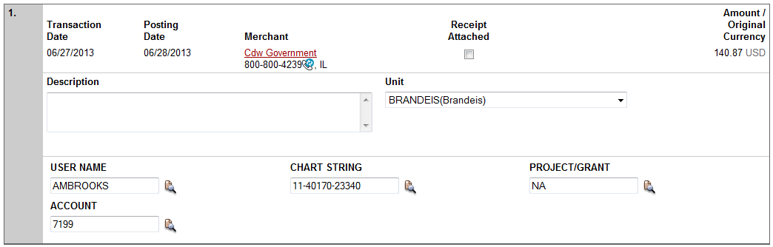


Reclassify screen
Enter a business description
Click the icon to choose values to reallocate the transaction
Account Code will always need to be changed from default value
Note: “User Name” must be same as your UNET ID and should not be changed
  Enter a business description, review/reclassify custom fields
  Avoid special characters - < > % ; ( ) & + \ # ? { } I ^ ~ [ ] “ ‘
  Please note the system will timeout after 15 minutes of inactivity. You will receive a warning message shortly before the session is set to expire.

Slide 27
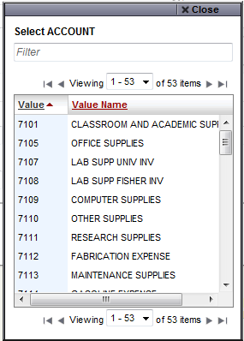
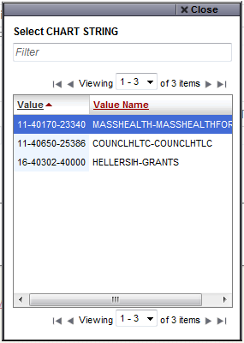
Reclassify screen

Slide 28
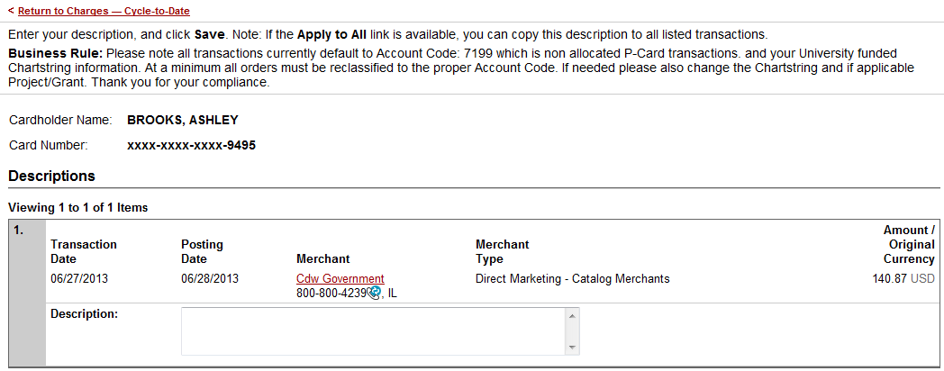

Add description screen
  Add a transaction description
  Provide a business purpose for travel related expenses
  Provide name of guests entertained
  Adhere to University policy
  Avoid special characters - < > % ; ( ) & + \ # ? { } I ^ ~ [ ] “ ‘

Slide 29
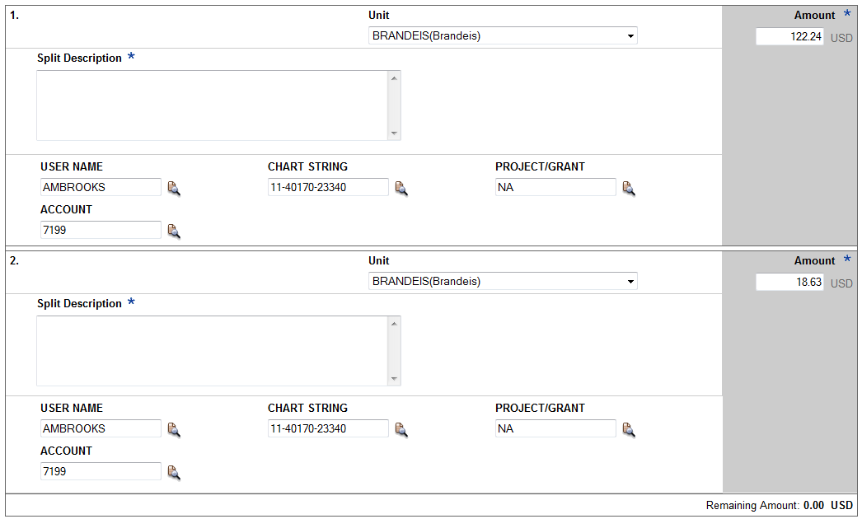

Split and reclassify screen
  Divide and reallocate a transaction into multiple entries
  Split by amount or by percentage
  Select add to create a new row and begin the split process

Slide 30
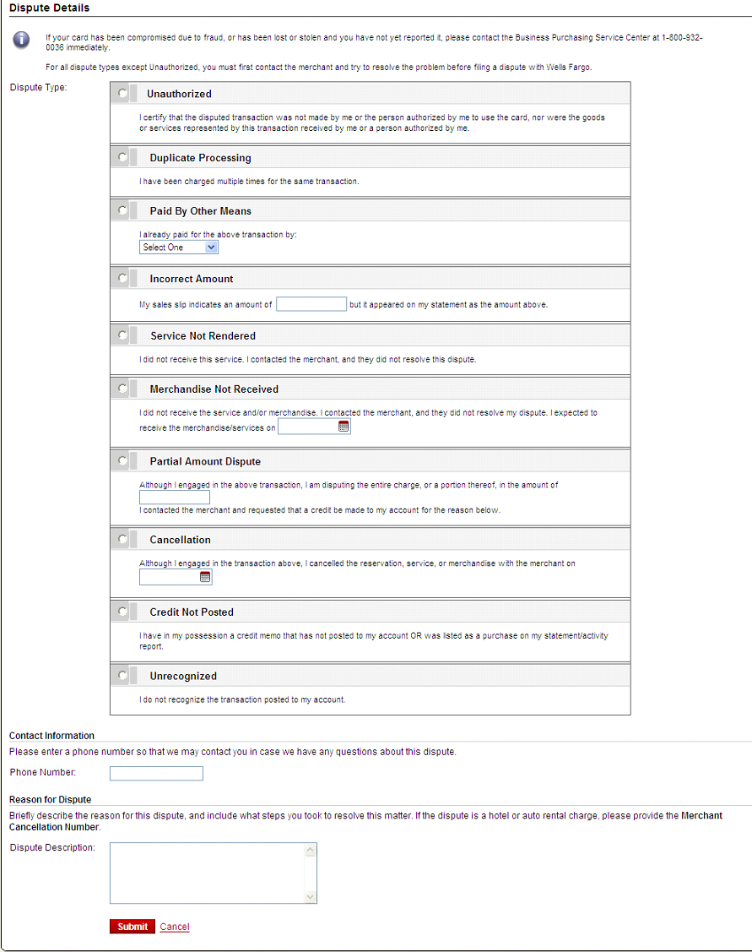
Dispute transaction screen
Please try to contact the vendor FIRST to get a refund or correction
If unresolved after working directly with the vendor, complete the online form
Notify program administrator of dispute
You have 60 days from the post date to dispute a transaction

Slide 31
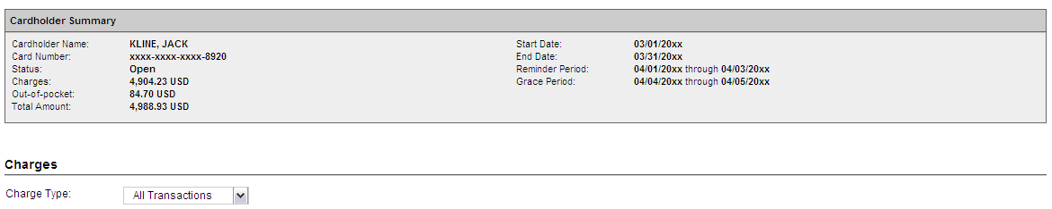
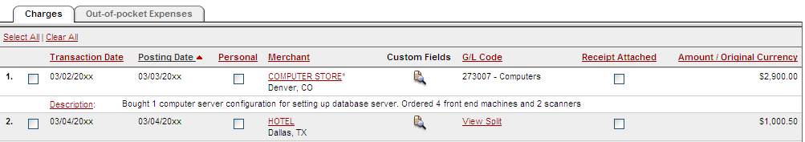
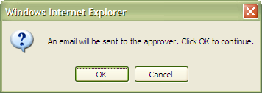

Complete your review
Select statement reviewed and a message box appears indicating that an email will be sent to your approver
Select cover sheet option on the “print” drop-down menu to print the cover sheet for this statement. Email or fax in receipts.

Slide 32
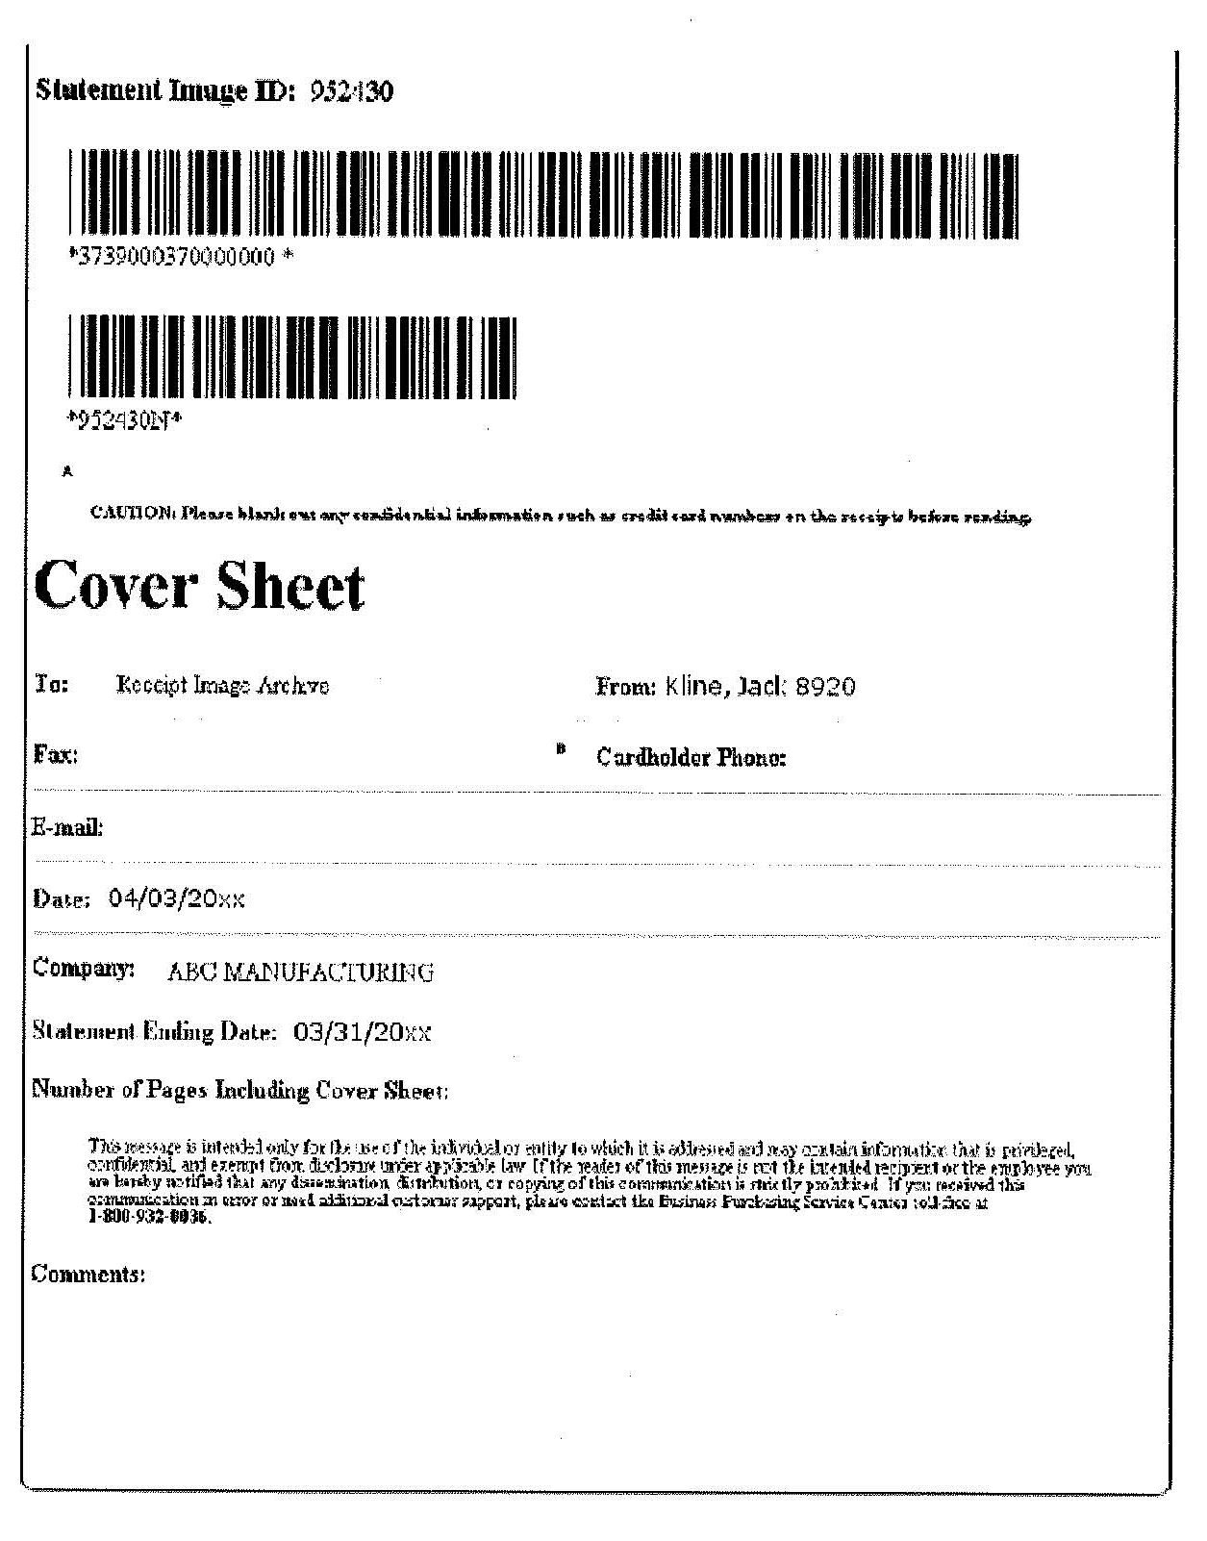
Receipt Imaging Cover Sheet
  Email – User emails a PDF containing the Cover Sheet at the beginning followed by the receipts for that statement period to: wf_ccard_receipts@mail2image.com
  Email Best Practices:
    The cover sheet printed from the system is the first page of the PDF and the bar codes on the cover sheet are clear and easy to read.
    All attachments are in the required PDF file format, and there are no other non PDF attachments in the email, i.e. signatures, pictures, email footers, etc.
    Attachments that are forwarded without opening the original e-mail will not be processed; they must be sent as a new email containing the PDF
    Multiple PDF file attachments in a single email are ok, but each PDF must begin with a unique cover sheet followed by the receipts for that statement.
    For the best quality, scan receipts in black and white only. Scanning receipts in color or using a scanner with software set to grayscale may alter the quality of the images during processing.
866-xxx-xxxx
wf_ccard_receipts@mail2image.com
Fax – User will fax the coversheet and receipts for the statement period to the 800 number provided

Slide 33
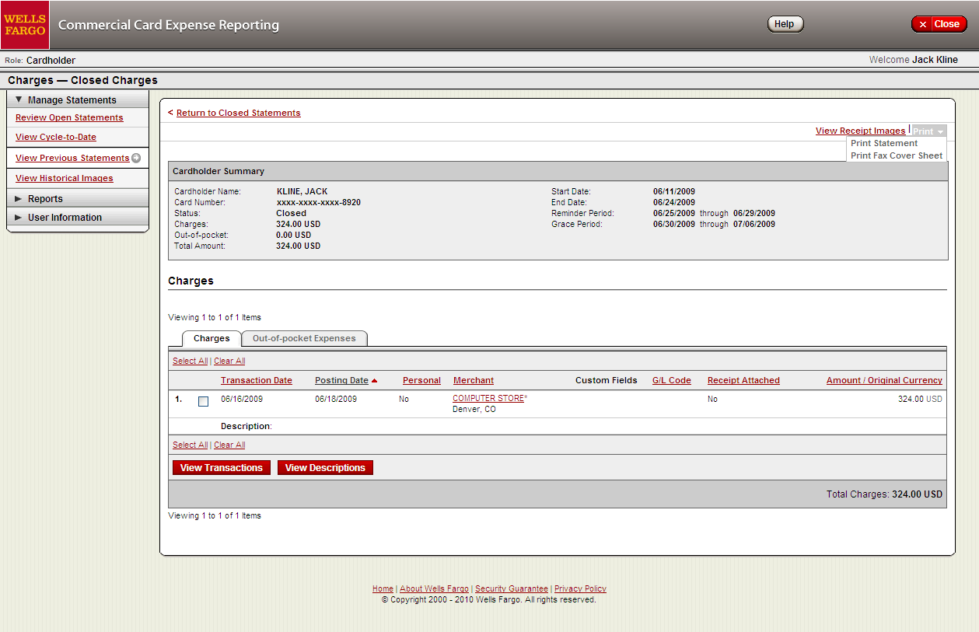

Viewing images and printing prior cover sheets
View images by clicking the “view receipt images” link found on the open statement and previous statement screens
Print cover sheets for prior statements on the view previous statement screen

Slide 34
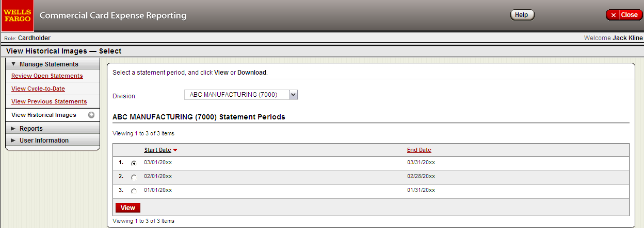
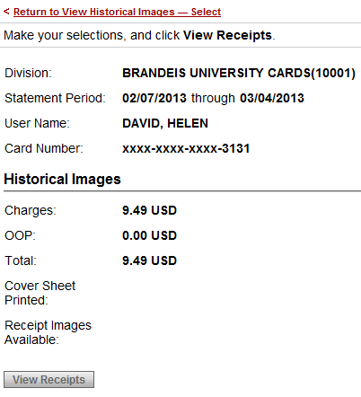
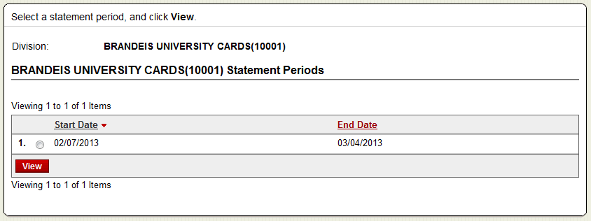
Viewing historical images
  View historical images for up to seven years via “view historical images”
  Select statement period and click view, then click view receipts

Slide 35
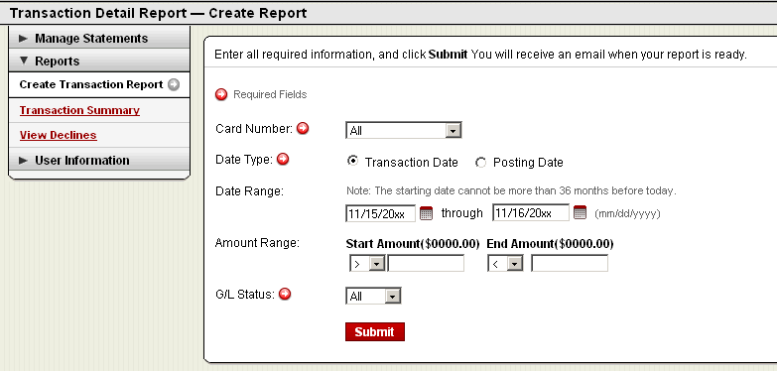
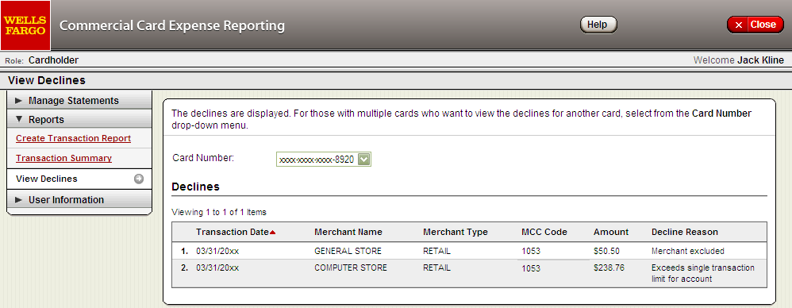
Reports
Run transaction reports with various filters
You are notified via e-mail when the report is ready
View declined transactions to determine the reason for the decline
Declines do not appear in real time, they will be displayed within 48 hours

Slide 36
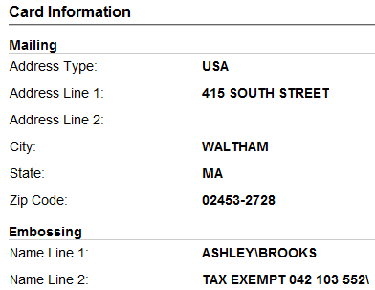
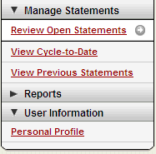
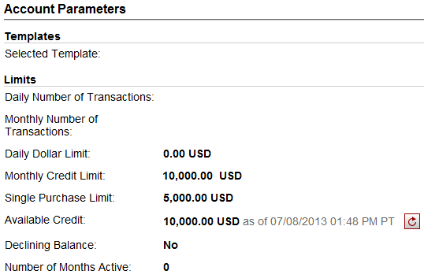
Personal profile
Billing address for online and phone orders
You can also contact the
Business Purchasing
Service Center 24/7 at
1-800-932-0036 to obtain available credit.
Must provide Unique ID (Employee ID) to
obtain any information
Click to retrieve current available credit
Available credit field is the remaining balance of the cardholder’s existing credit limit

Slide 37
Cardholder Responsibility
Collect receipts to verify purchases for auditing
Watch for unauthorized transactions on your statement and report/dispute them immediately
Dispute any incorrect charges with the vendor directly before filing an online or paper dispute form
Complete your reconciliation by the due date
Keep the card (and card number) confidential

Slide 38
Contact information
Wells Fargo - 1-800-932-0036
  From outside of the United States call 1-612-332-2224
  Call immediately if your card is lost, stolen or suspected missing
  For immediate decline information
  To access the automated voice response system for the following information:
    Current balance
    Available credit
Contact a program administrator if:
  You have questions about your card
  Need to increase your credit limit
  Change jobs
  Need to order cards for other employees
Program administrators:
Courtney Sampson
Helen David

Slide 39
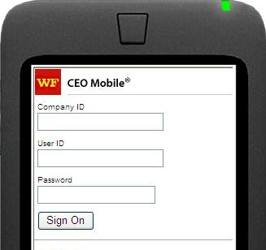
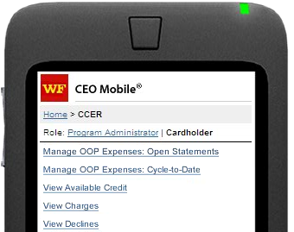
CCER access via CEO Mobile
CEO Mobile Service
  Access via the browser on your mobile device using your Company ID, User ID and Password at: https://ceomobile.wf.com
  iPhone users can go to the APP Store and download the CEO Mobile® app
  An online tutorial can be viewed at: https://wellsoffice.wellsfargo.com/ceo_public/tutorial/ccer_mobile/index.html
Cardholders can:
  Add/edit out-of-pocket expenses
  View available credit
  View posted card charges
  View declines

Slide 40
Approver experience

Slide 41
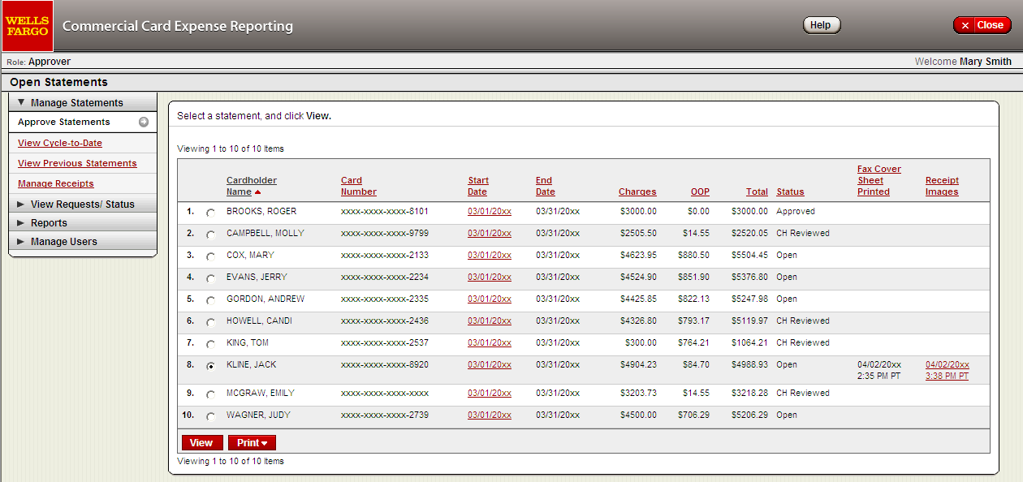
Manage Statements
Statement approval queue (if the cycle is ready for review)
View images by clicking the link in the receipt images column
Notify program administrator if a secondary approver is needed

Slide 42
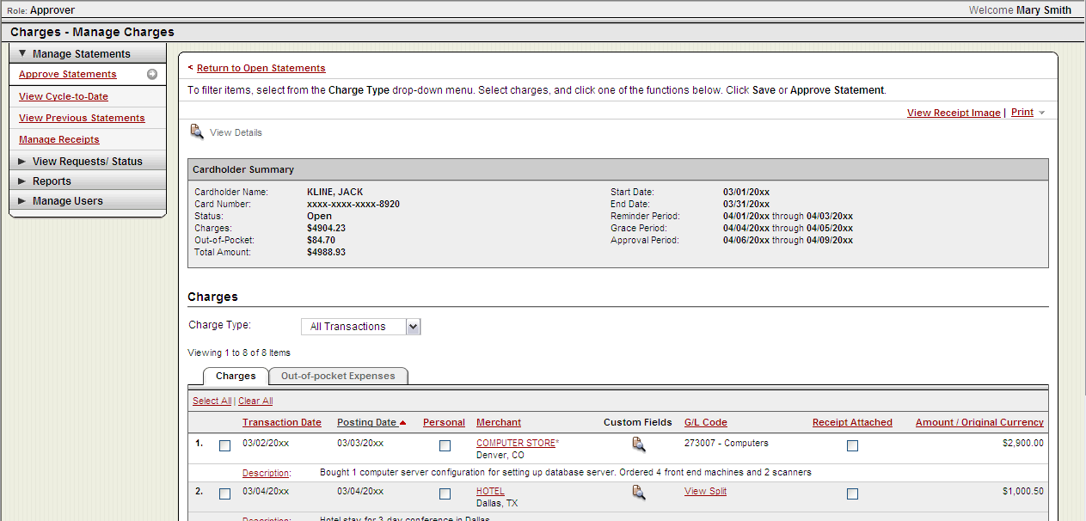
Viewing images: statement approval and previous statements pages
The approver can view images by clicking the “view receipt images” link on the approve statements and the view previous statements pages

Slide 43
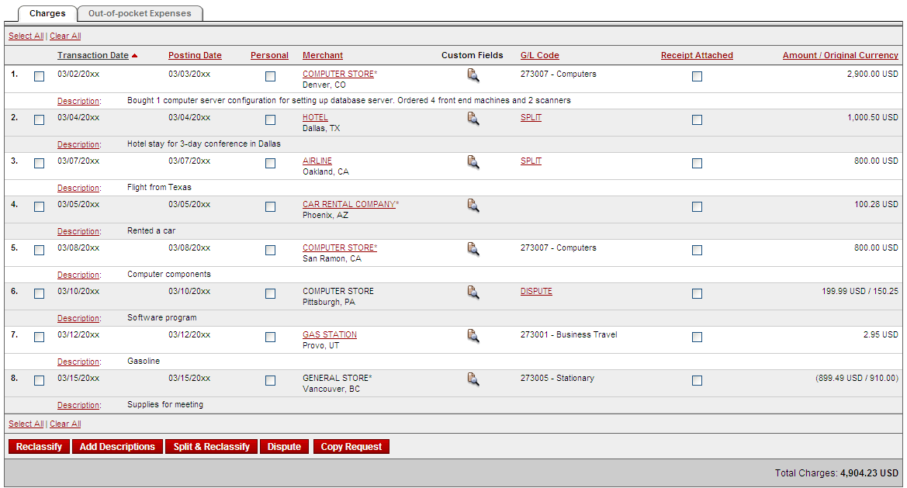
Select All
Select Reclassify

Slide 44
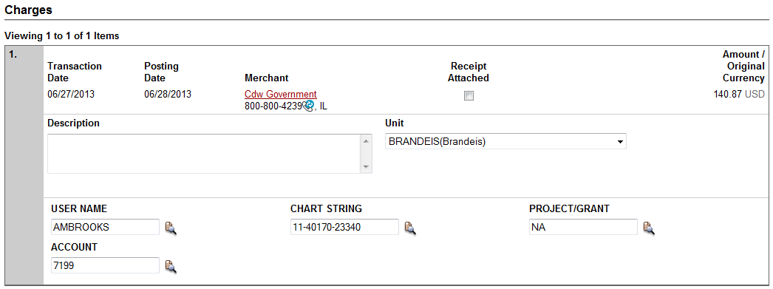
View reclassifications
View transaction details
Make changes if necessary

Slide 45
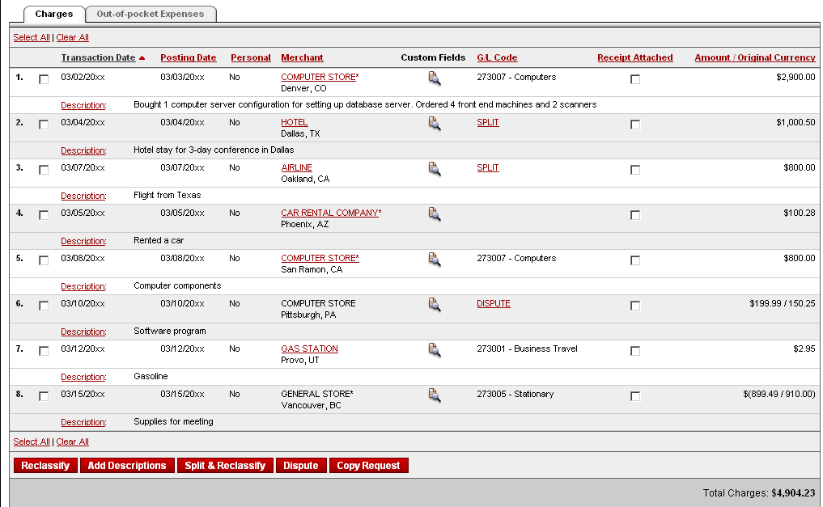

Statement approval
Review transaction detail, descriptions, receipts, and make
sure all are in compliance with University policy for all charges
Approve the card expenses by clicking “approve statement”

Slide 46
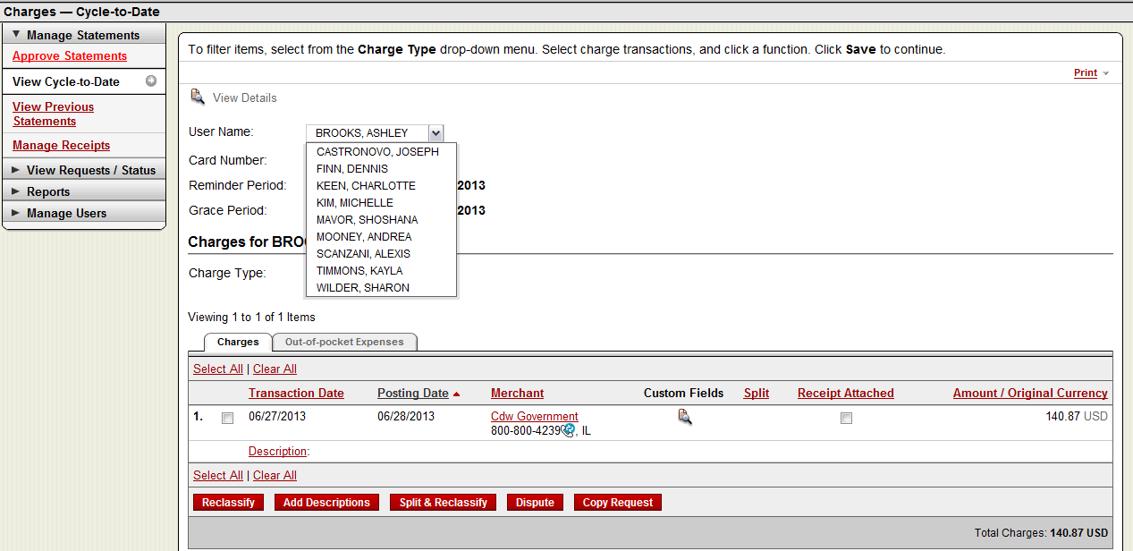
Manage Statements
Cycle-to-date transactions
Approvers can view activity for any cardholder that rolls up to them for approval

Slide 47
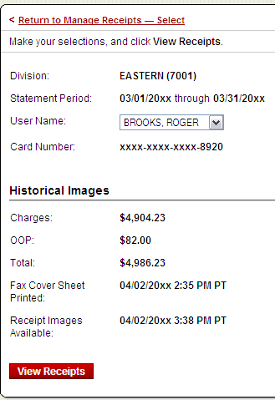


Manage receipts: Review receipts/view historical images tabs
Manage receipts page contains two tabs that allow the approver to select a particular statement period and view receipts:
Review receipts tab contains data for the last twelve months
View historical images tab contains data for the last seven years

Slide 48

Reports – statement summary
Statement summary report showing cardholder statements over period of time

Slide 49


Reports - offline

Slide 50
Thank you!

